Slide 1


RAJIV GANDHI
INSTITUTE OF TECHNOLOGY
Department of Computer Science and Engineering
Rise Together:
A Crowdfunding Platform
Join us as we explore the world of blockchain and crowdfunding, and see how these two technologies can come together to form the future of fundraising.
Ethereum Smart Contract
Presented By:
Under the Guidance of:
Mrs. Kavyashree J
Assistant Professor,
Dept. of CSE, RGIT.
Bhavana S K (1RG20CS019)
Madhu S (1RG20CS033)
N Deepak (1RG20CS038)
Santhosh P (1RG20CS050)

Slide 2

Abstract
The project titled “Rise Together: A Crowdfunding platform” introduces a groundbreaking Crowdfunding Platform on the Ethereum blockchain, revolutionizing traditional fundraising models. Leveraging smart contracts for seamless automation and execution of campaigns, the platform ensures transparency, security, and efficiency. Ethereum's decentralization eliminates intermediaries, reducing costs, and enhancing accessibility. Key features include a user-friendly interface, contribution tracking, and real time campaign monitoring. Utilizing Ether as the native cryptocurrency streamlines contributions, offering a secure and standardized means of support. Positioned at the intersection of blockchain and fundraising, this project contributes to the evolution of decentralized finance, showcasing Ethereum's potential for secure, inclusive, and innovative crowdfunding.

Slide 3
The Traditional Way of Crowdfunding
Crowdfunding is a way for people, businesses, and creative projects to get money from a group of supporters. We'll look at how crowdfunding started in the past and how it has changed over time. It all began with regular folks working together and pooling their money to help each other. By learning about the early days and what made crowdfunding work, we can understand how it has improved with new technology. So, let's take a trip back in time to see where crowdfunding came from and what exciting things might happen in the future.

Slide 4
Drawbacks Of Traditional Way of Crowdfunding
Limitations
Low Trust
Lengthy Process
High fees, lack of transparency and security, lower success rates due to dependence on various intermediaries.
There are no effective means to ensure that the project’s creator will use the funds received in a way that aligns with the interests of the funders.
Takes a long time to set up a crowdfunding campaign and get the project funds; complicated and time-consuming.

Slide 5
The Proposed Platform
1
Blockchain-based Platform
2
Peer-to-peer
A decentralized platform, open to all, that allows creators to fundraise from anywhere in the world without the need for intermediaries.
A peer-to-peer network that connects creators with funders, allows for secure and transparent fundraising and enables transactions to be verified and publicly audited.
3
Ease of Use
4
Customizable Features
A simple, user-friendly interface that simplifies the crowdfunding process and reduces the time it takes to bring your project to life.
The platform offers customizable features, including rewards and incentives that allow creators to incentivize funders and increase their chances of success.

Slide 6

The Future of Crowdfunding
1
New Funding Opportunities
Blockchain technology creates new ways of accessing funds and allows anyone to attract supporters and investors from all around the globe.
2
Increased Transparency
A transparent fundraising process benefits the creator, investors, and the wider community, creating a new kind of investment culture through democratic collaboration.
3
Lower Fees & Fewer Intermediaries
A decentralized platform with fewer intermediaries means lower fees and fewer barriers to entry, creating opportunities for more people to participate in financing projects.

Slide 7
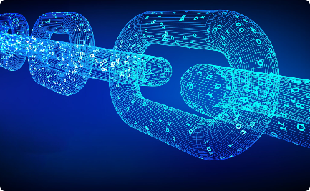


The Blockchain Solution
Increased Security
Transparency
Multiple Use Cases
Blockchain technology verifies each transaction, ensuring that the fund’s transfers are secure and tamper-proof.
All activities on the network are transparent and secure, eliminating the need for intermediaries and ensuring total trust among all parties.
Blockchain can be used for any kind of fundraising project, no matter how large or small, and offers greater flexibility and ease of use.

Slide 8


Objective and Problem Statement
Objective:
Revolutionize fundraising through the implementation of blockchain technology.
Enhance the crowdfunding experience by leveraging the unique features of blockchain.
Problem Statement:
Trust and safety issues prevalent in traditional crowdfunding platforms.
Inefficiencies and delays associated with centralized intermediaries.
Limited global accessibility and participation in crowdfunding campaigns.
High transaction costs and complex processes hindering the efficiency of traditional crowdfunding.

Slide 9
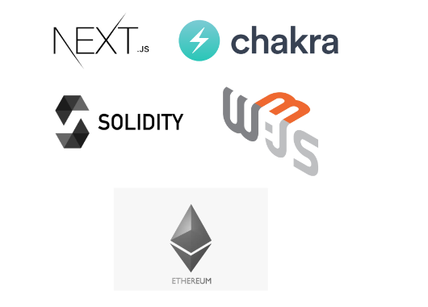

Technologies used
NextJS :
Next.js is an open-source React front-end development web framework that enables functionality such as server-side rendering and generating static websites for React based web applications.
2. Solidity :
It is the programming language for implementing Ethereum based Smart Contracts.
3. Web3 :
web3.js is a collection of libraries that allow you to interact with a local or remote Ethereum node using HTTP, IPC or WebSocket.
4.Ethereum Smart Contract :
It is the collection of functions and data that reside at a specific address on the Ethereum Blockchain.

Slide 10
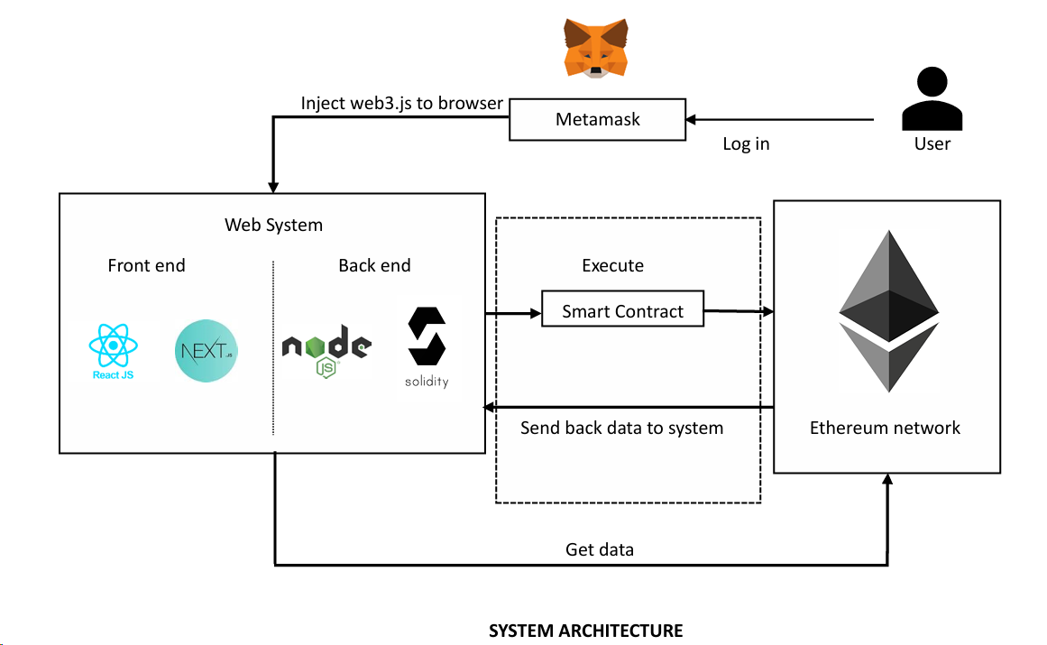

Slide 11
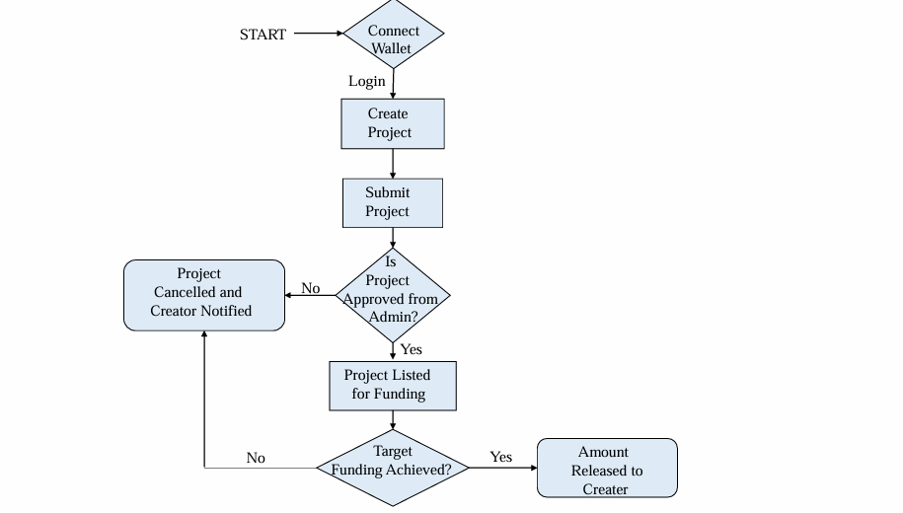
Data Flow Diagram

Slide 12
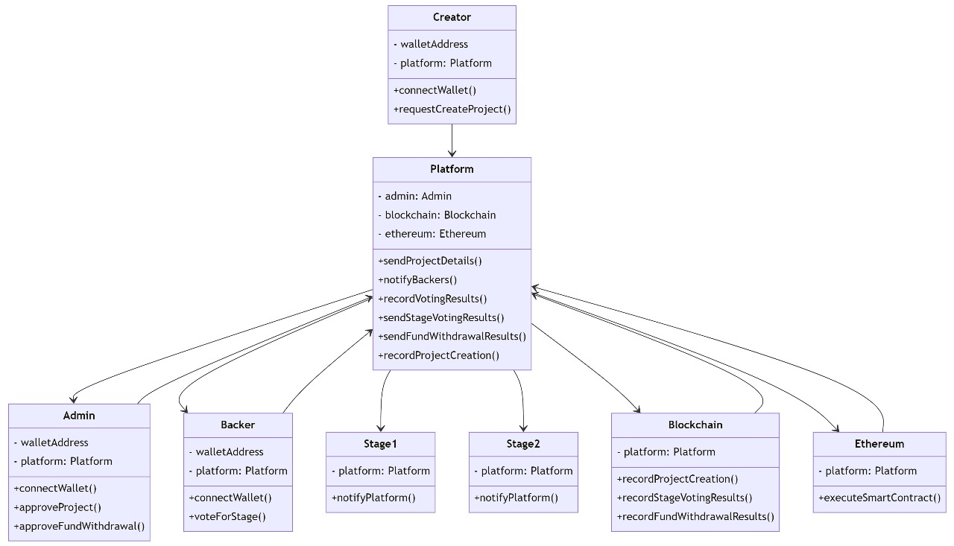
Class Diagram

Slide 13
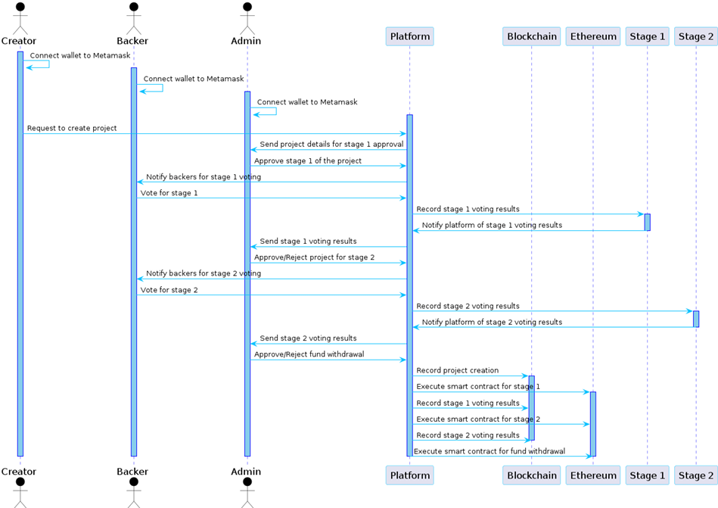
Sequence Diagram

Slide 14
Gantt Chart
Gantt Chart
16/09/
2023
01/11/
2023
15/11/
2023
22/12/
2023
03/01/
2024
20/04/
2024
04/05/
2024
Completed
PROJECT PLANNING
REQUIREMENT ANALYSIS
PROTPTYPE DESIGN
DOCUMENTATION
IMPLEMENTATION
INTEGRATION & TESTING
Completed
Completed
Completed
Completed
Planned

Slide 15
Conclusion
In closing, blockchain-based crowdfunding offers a game-changing solution for raising funds efficiently and effectively. It enables global connectivity, allowing projects to connect with supporters from around the world, transcending geographical constraints. The heightened levels of security, transparency, and trust associated with this technology significantly elevate the prospects of campaign success. By embracing blockchain, projects can tap into a vast and borderless network of backers who share their vision. This innovation is revolutionizing the crowdfunding landscape and empowering ventures to bring their ideas to fruition with greater confidence. It's not just about raising funds; it's about forging a global community of support for your project.

Slide 16
ANY QUESTIONS

Slide 17

Thank You!

